Slide 1
資訊安全 Chapter 5 Database & Data Center Security 資料庫與資料中心安全
Joseph Deng
josephdeng@g2.usc.edu.tw

Slide 2
Outline 大綱
The Need for Database Security
Database Management Systems
Relational Databases
SQL Injection Attacks
Database Access Control
Inference
Database Encryption
Data Center Security

Slide 3
Learning Objectives 學習目標
The unique need for database security, separate from ordinary computer security measures. 資料庫獨特的資安需求
The basic elements of a database management system. 資料庫
The basic elements of a relational database system. 關聯式資料庫
SQL injection attacks.
Compare and contrast different approaches to database access control. 資料庫存取控制
How inference poses a security threat in database systems. 推理
The use of encryption in a database system. 加密
Security issues related to data centers. 資料中心資安議題

Slide 4
The Need For Database Security
為什麼要強調資料庫安全？
資料庫只是伺服器上執行的一個服務，整部伺服器安裝一套防毒軟體，保護了伺服器就保護了資料庫不是？

Slide 5
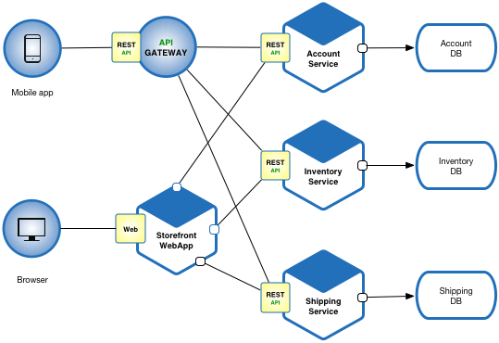
The Need For Database Security
Organizational databases tend to concentrate sensitive information in a single logical system
Notes:
https://microservices.io/

Slide 6
Reasons database security has not kept pace with the increased reliance on databases
There is a dramatic imbalance between the complexity of modern database management systems and the security technique used to protect these critical systems 資料庫系統變得太快、太複雜了
Databases have a sophisticated interaction protocol, Structured Query Language (SQL), which is complex
Effective database security requires a strategy based on a full understanding of the security vulnerabilities of SQL 專業的 DBA 養成不易，薪水高
Transaction Management
A: Atomic
C: Consist
I: Isolated
D: Durable
Mirror
Distributed Transaction Management
Database
Replication

Slide 7
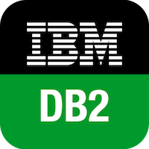
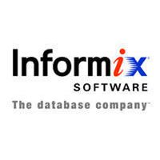

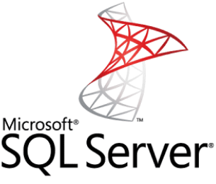
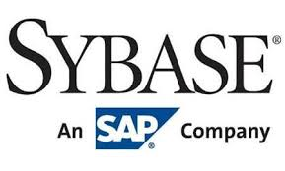


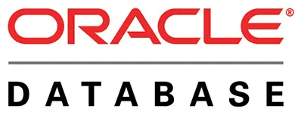
Reasons database security has not kept pace with the increased reliance on databases
The typical organization lacks full-time database security personnel 缺專人維護資安
Most enterprise environments consist of a heterogeneous （異質）mixture of database platforms, enterprise platforms, and OS platforms, creating an additional complexity hurdle for security personnel
The increasing reliance on cloud technology to host part or all of the corporate database 都往雲端去

Slide 8
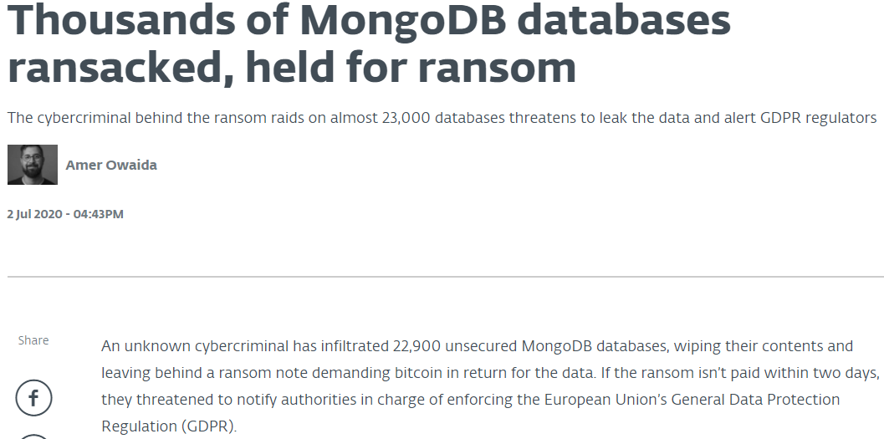
https://www.welivesecurity.com/2020/07/02/thousands-mongodb-databases-ransacked-held-ransom/
被洗劫
勒索贖金
網站開發者都愛 MongoDB，但是很少有人幫管理員帳號設定密碼！
Microsoft SQL Server 的管理員帳號是 sa，密碼………..通常是空白！

Slide 9
Database Management Systems
資料庫管理系統簡介

Slide 10
Database 資料庫
Structured collection of data stored for use by one or more applications 結構化的資料
Contains the relationships between data items and groups of data items 資料之間相互關聯
Can sometimes contain sensitive data that needs to be secured 存放機敏資料
Query language 查詢語言
Provides a uniform interface to the database for users and applications

Slide 11
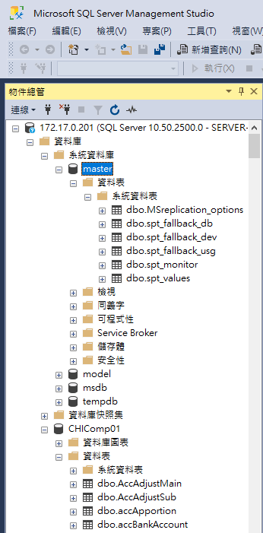
Database Management System (DBMS)
Suite of programs for constructing and maintaining the database 管理資料庫系統
Offers ad hoc query facilities to multiple users and applications 查詢工具

Slide 12
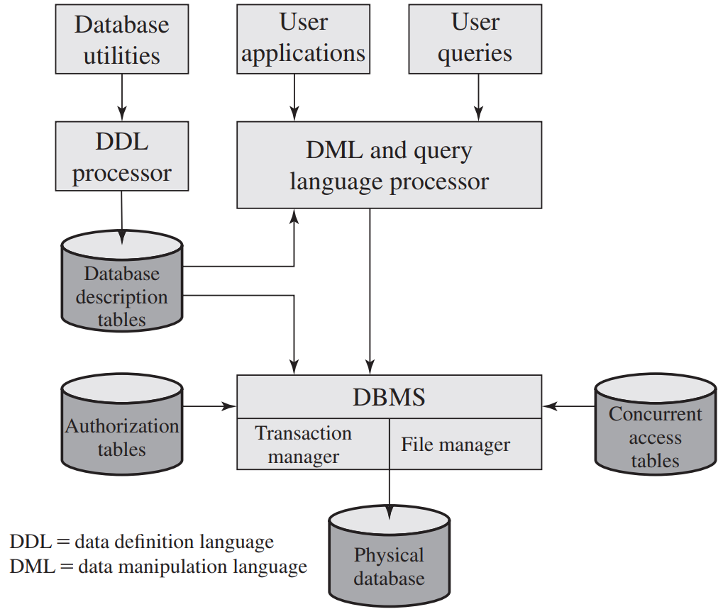
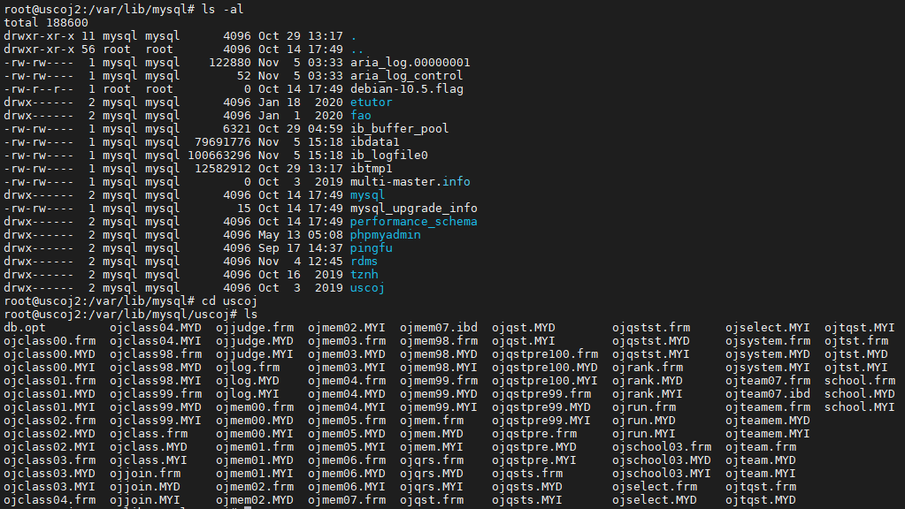
Figure 5.1 DBMS Architecture

Slide 13
Relational Databases 關聯式資料庫
Table of data consisting of rows and columns
Each column holds a particular type of data
Each row contains a specific value for each column
Ideally has one column where all values are unique, forming an identifier/key for that row
Enables the creation of multiple tables linked together by a unique identifier that is present in all tables
Use a relational query language to access the database
Allows the user to request data that fit a given set of criteria

Slide 14
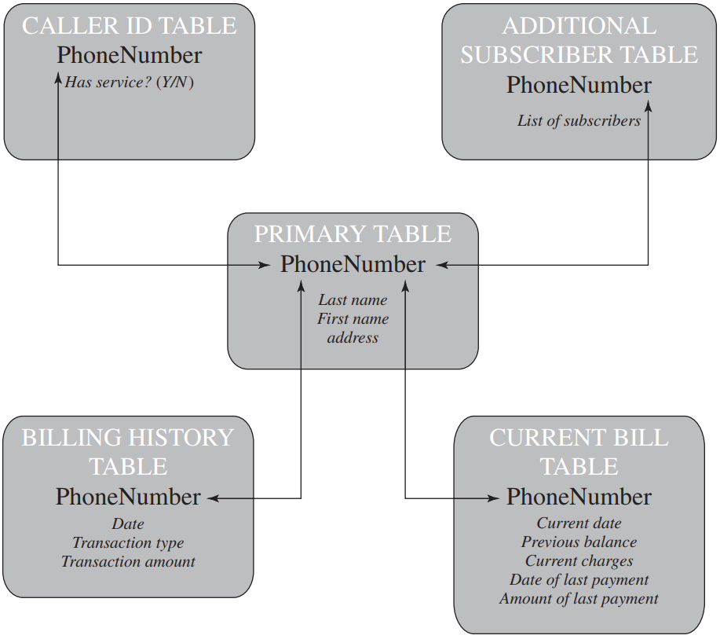
Figure 5.2 Example Relational Database Model
A relational database uses multiple tables related to one another by a designated key; in this case the key is the Phone-Number field.

Slide 15
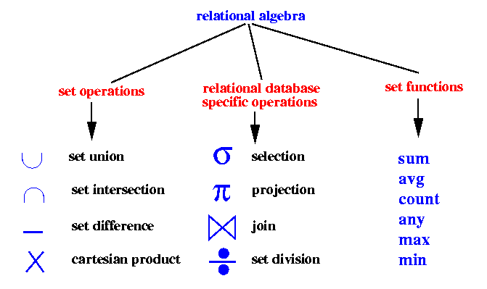
E.F. Codd and Relational Algebra 關聯式代數
The term "relational database" was invented by E. F. Codd at IBM in 1970.
Codd introduced the term in his research paper "A Relational Model of Data for Large Shared Data Banks".
In this paper and later papers, he defined what he meant by "relational".
數學模型對了，資料結構和演算法就不會出錯，系統運作才能夠穩定。
Notes:
https://medium.com/@sahirnambiar/relational-algebra-the-underpinnings-of-sql-74959481231a

Slide 16
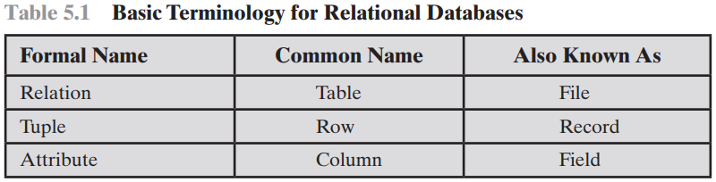
Elements of a Relational Database System
Relation 關聯
A flat table 資料表
Tuples 值組
Rows 資料列
Attributes 屬性
Columns 資料行

Slide 17
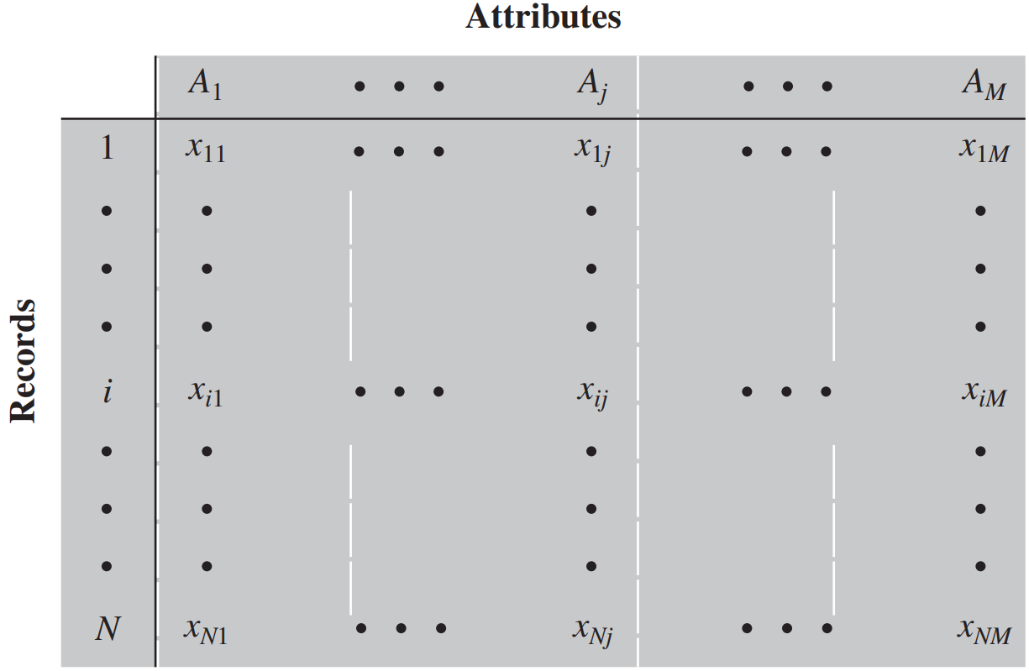
Figure 5.3 Abstract Model of a Relational Database
Each attribute A_{j} has |A_{j}| possible values
x_{ij} denoting the value of attribute j
for entity i
N individuals, or Entities

Slide 18
Elements of a Relational Database System
Primary key 主鍵
Uniquely identifies a row 識別項
Consists of one or more column names 可以是組合鍵
Foreign key 外來鍵/外部鍵
Links one table to attributes in another
View/virtual table 檢視表
Result of a query that returns selected rows and columns from one or more tables
Views are often used for security purposes 唯讀、遮蔽

Slide 19
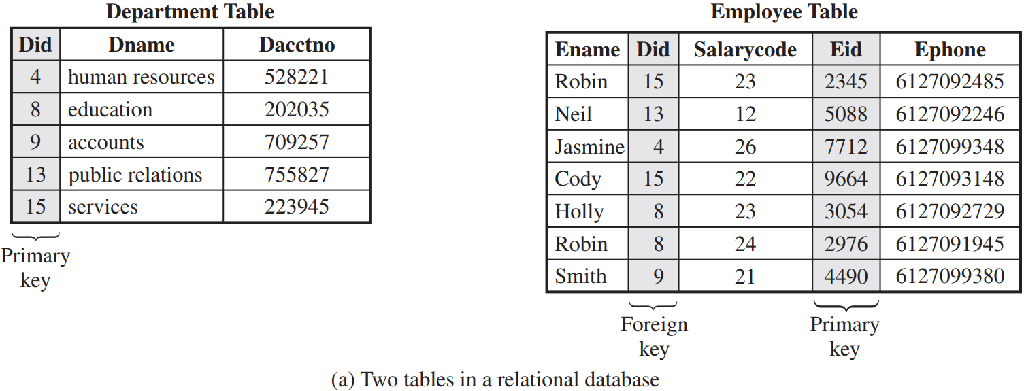
Figure 5.4 Relational Database Example

Slide 20
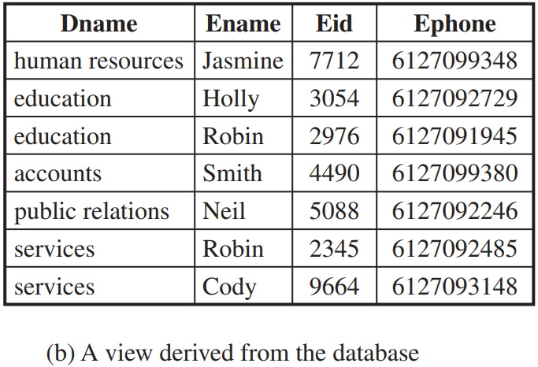
Figure 5.4 Relational Database Example

Slide 21
Structured Query Language (SQL)
Standardized language to define schema, manipulate, and query data in a relational database
Several similar versions of ANSI/ISO standard
All follow the same basic syntax and semantics
SQL statements can be used to:
Create tables
Insert and delete data in tables
Create views
Retrieve data with query statements

Slide 22
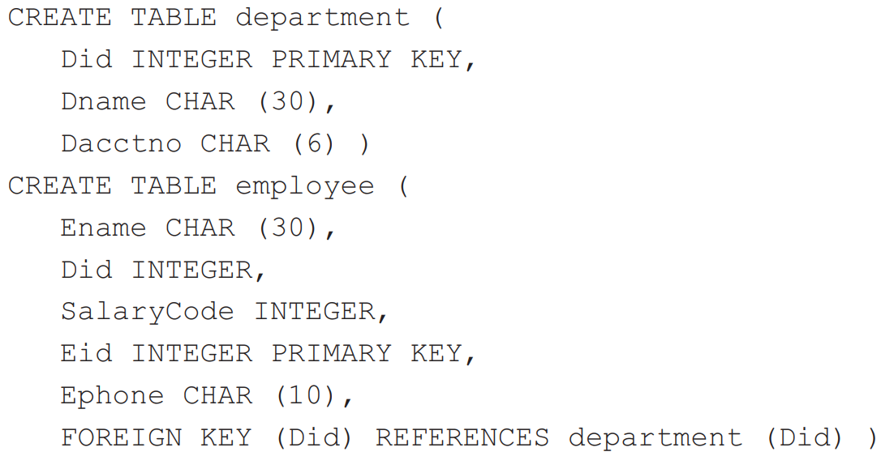
DDL: Create Table

Slide 23
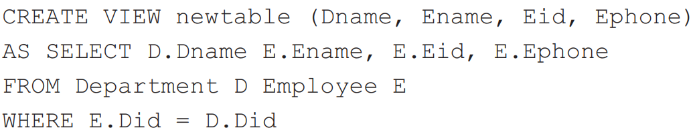
DDL: Create View

Slide 24
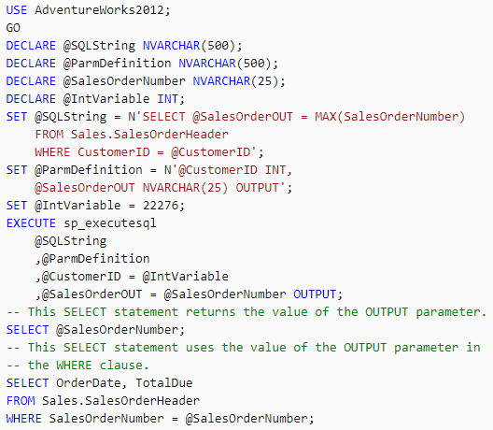
執行動態建立的 SQL 字串
使用 OUTPUT 儲存參數中的語句所產生的結果集

Slide 25
SQL Injection (SQLi) Attack
因為 SQL 是字串，可以動態產生然後被執行，
所以我們不知道下一刻鐘被執行的指令內容！

Slide 26
SQL Injection (SQLi) Attack
One of the most prevalent and dangerous network-based security threats
Designed to exploit the nature of Web application pages
Sends malicious SQL commands to the database server
Most common attack goal is bulk extraction of data 以偷資料為主
Depending on the environment SQL injection can also be exploited to:
Modify or delete data 竄改、刪除
Execute arbitrary operating system commands 執行作業系統命令
Launch denial-of-service (DoS) attacks 阻絕服務

Slide 27
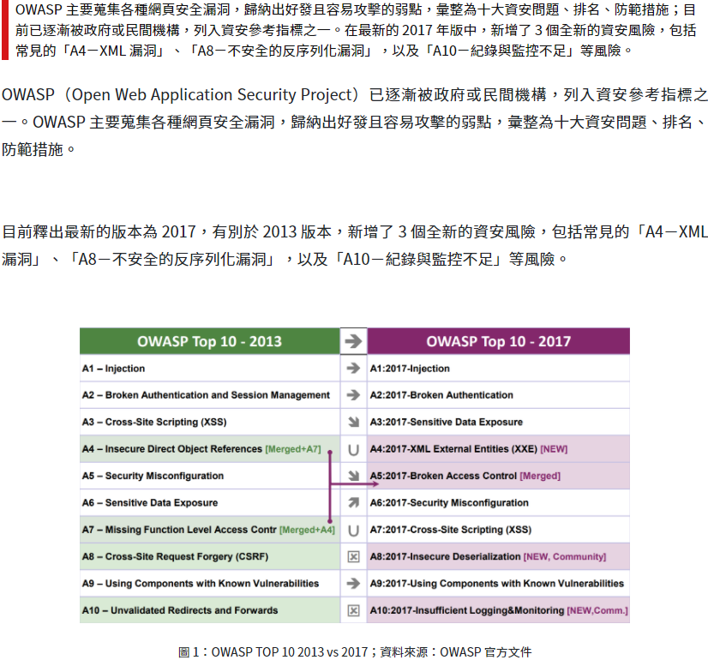
https://secbuzzer.co/post/116

Slide 28
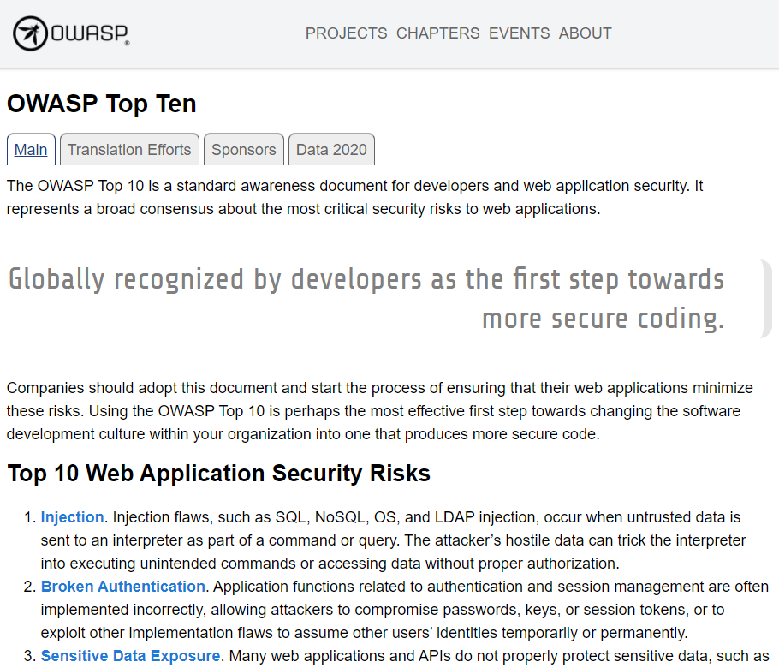
https://owasp.org/www-project-top-ten/
2020年還是排第一！

Slide 29
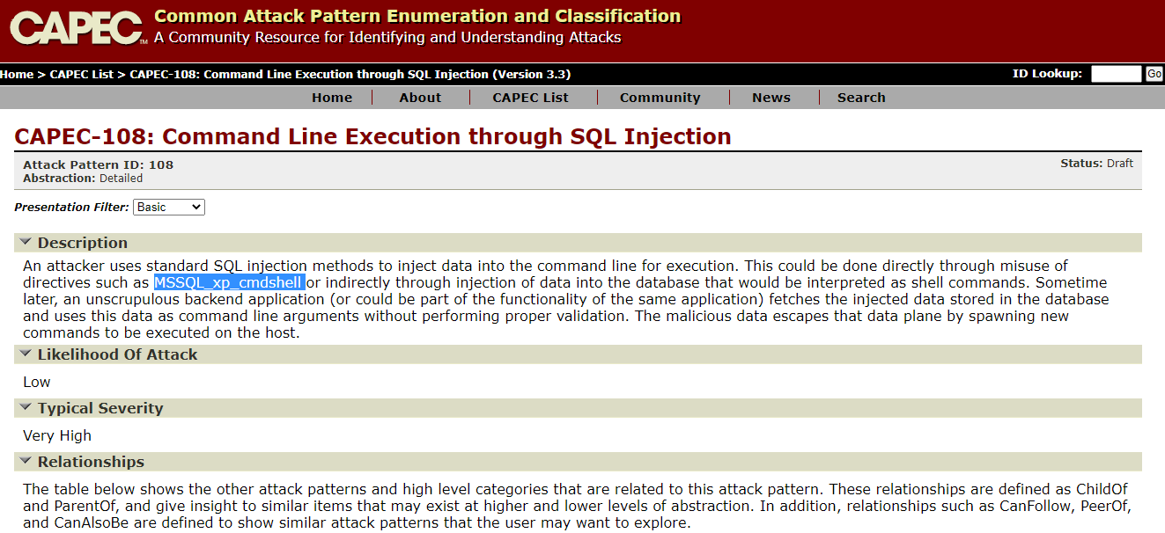
https://capec.mitre.org/data/definitions/108.html

Slide 30
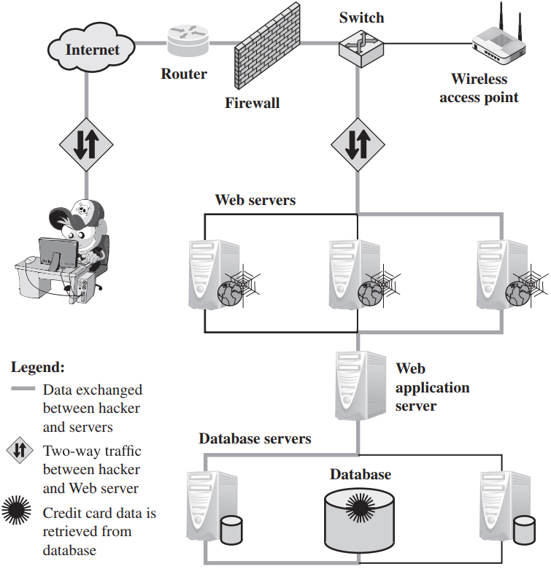
A Typical SQL Injection Attack
指令直達資料庫！

Slide 31
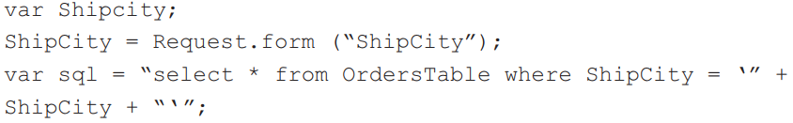
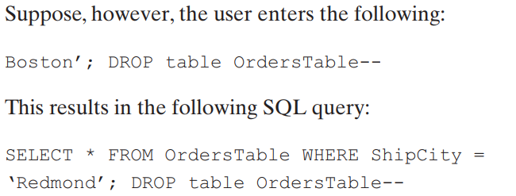
The Injection Technique
-- 是SQL的註解符號

Slide 32
The Injection Technique
The SQLi attack typically works by prematurely terminating a text string and appending a new command
Because the inserted command may have additional strings appended to it before it is executed the attacker terminates the injected string with a comment mark "- -"
Subsequent text is ignored at execution time

Slide 33
SQLi Attack Avenues 途徑
User input
Attackers inject SQL commands by providing suitable crafted user input
Server variables
Attackers can forge the values that are placed in HTTP and network headers and exploit this vulnerability by placing data directly into the headers
http://testsys.im.usc.edu.tw/sg.php?quizid=1061218%20OR%201%3D1%20--&testid=1061218
http://testsys.im.usc.edu.tw/sg.php?quizid=1061218 OR 1=1 --&testid=1061218

Slide 34
SQLi Attack Avenues 途徑
Second-order injection
A malicious user could rely on data already present in the system or database to trigger an SQL injection attack, so when the attack occurs, the input that modifies the query to cause an attack does not come from the user, but from within the system itself
如果可以在留言板的文字裡面輸入 HTML Tag，就可以埋一個開啟網頁的 <iframe>，將惡意網址藏在裡面，
<iframe src="http://testsys.im.usc.edu.tw/sg.php?quizid=1061218%20OR%201%3D1%20--&testid=1061218" width=0 height=0 />
下次使用者瀏覽留言板時 <iframe> 就會被打開，網址會被拜訪，但是畫面上看不到。

Slide 35


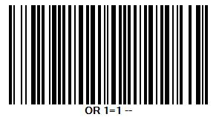
SQLi Attack Avenues 途徑
Cookies
An attacker could alter cookies such that when the application server builds an SQL query based on the cookie’s content, the structure and function of the query is modified
Physical user input
Applying user input that constructs an attack outside the realm of web requests

Slide 36
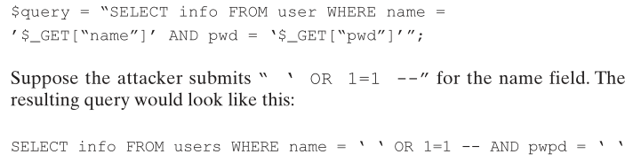
Inband Attacks
Uses the same communication channel for injecting SQL code and retrieving results
The retrieved data are presented directly in application Web page, include:
Tautology 滔滔不絕
Injects code in one or more conditional statements so that they always evaluate to true
End-of-line comment
After injecting code into a particular field, legitimate code that follows are nullified through usage of end of line comments
Piggybacked queries 順風車
The attacker adds additional queries beyond the intended query, piggy-backing the attack on top of a legitimate request

Slide 37
Inferential Attack
There is no actual transfer of data, but the attacker is able to reconstruct the information by sending particular requests and observing the resulting behavior of the Website/database server
Include:
Illegal/logically incorrect queries
This attack lets an attacker gather important information about the type and structure of the backend database of a Web application
The attack is considered a preliminary, information-gathering step for other attacks
Blind SQL injection
Allows attackers to infer the data present in a database system even when the system is sufficiently secure to not display any erroneous information back to the attacker

Slide 38
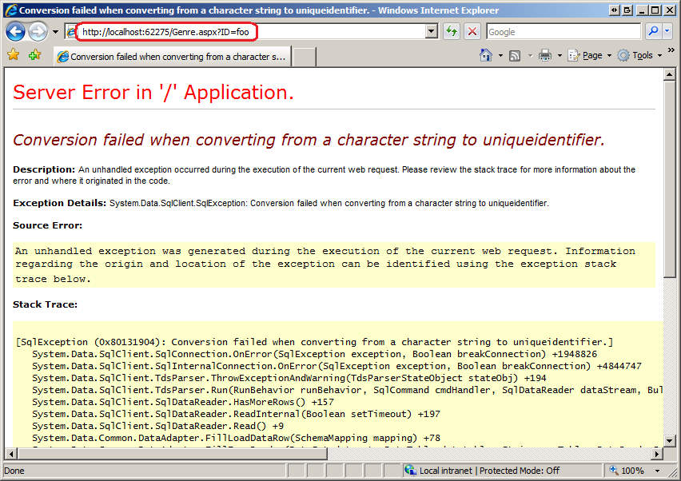
好用的除錯畫面，透露太多細節！

Slide 39
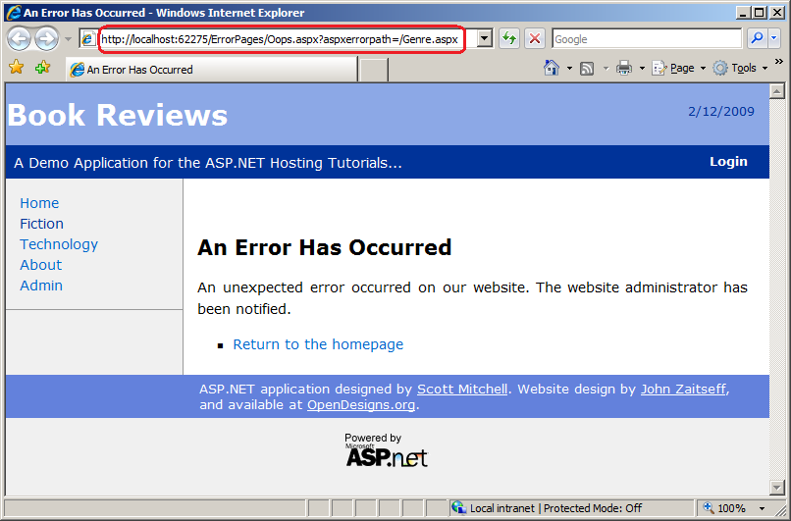
官僚、無用但是卻安全的報錯畫面：

Slide 40
Out-of-Band Attack
Data are retrieved using a different channel
This can be used when there are limitations on information retrieval, but outbound connectivity from the database server is lax

Slide 41
SQLi Countermeasures 對策
Defensive coding
Manual defensive coding practices
Type checking
Pattern matching (Regular Expression)
Parameterized query insertion
SQL DOM
Detection
Signature based
Anomaly based
Code analysis
Run-time prevention
Check queries at runtime to see if they conform to a model of expected queries

Slide 42
Parameterized Query Insertion
SqlCommand cmd = new SqlCommand("INSERT INTO CurrentSit VALUES(@sitid1, @incident1, @nature1, @name1, @charges1)", con);
cmd.Parameters.AddWithValue("@sitid1", sitid1);
cmd.Parameters.AddWithValue("@incident1", incident1.ToString("YYYY-mm-DD"));
cmd.Parameters.AddWithValue("@nature1", nature1);
cmd.Parameters.AddWithValue("@name1", name1);
cmd.Parameters.AddWithValue("@charges1", charges1);
cmd.ExecuteNonQuery();

Slide 43
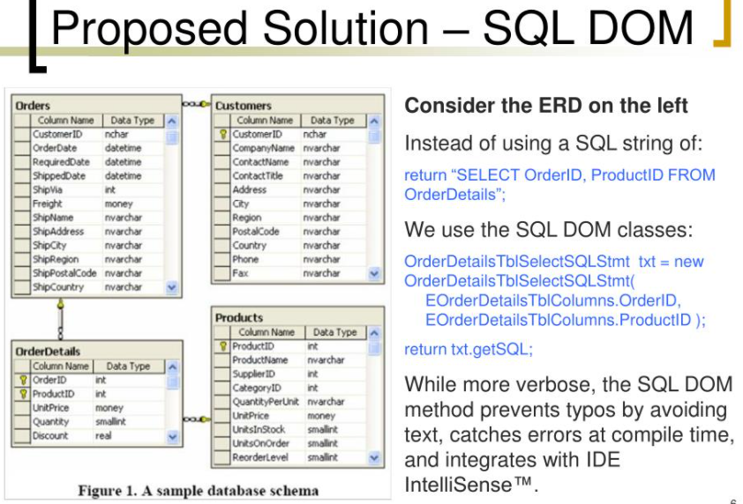
https://www.slideserve.com/theola/sql-dom

Slide 44
Database Access Control

Slide 45
Database Access Control
Database access control system determines:
If the user has access to the entire database or just portions of it 範圍
What access rights the user has (create, insert, delete, update, read, write) 動作
Can support a range of administrative policies
Centralized administration
Small number of privileged users may grant and revoke access rights
Ownership-based administration
The creator of a table may grant and revoke access rights to the table
Decentralized administration
The owner of the table may grant and revoke authorization rights to other users, allowing them to grant and revoke access rights to the table

Slide 46
SQL Access Controls
Two commands for managing access rights:
Grant
Used to grant one or more access rights or can be used to assign a user to a role
Revoke
Revokes the access rights
Typical access rights are:
Select
Insert
Update
Delete
References

Slide 47
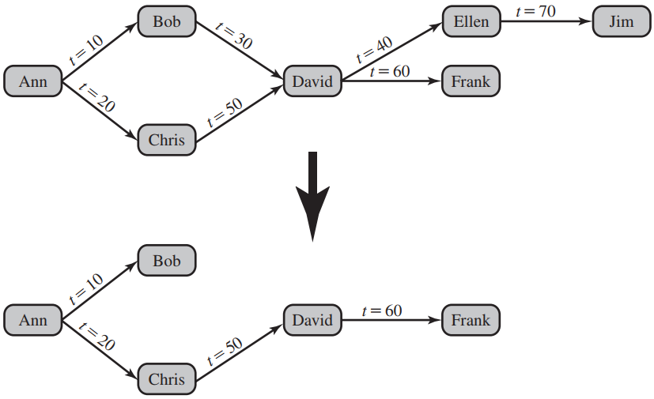
Cascading Authorizations Figure 5.6 Bob Revokes Privilege from David
When user A revokes an access right, any cascaded access right is also revoked, unless that access right would exist even if the original grant from A had never occurred.

Slide 48
Role-Based Access Control(RBAC)
Application owner
An end user who owns database objects as part of an application
End user
An end user who operates on database objects via a particular application but does not own any of the database objects
Administrator
User who has administrative responsibility for part or all of the database

Slide 49
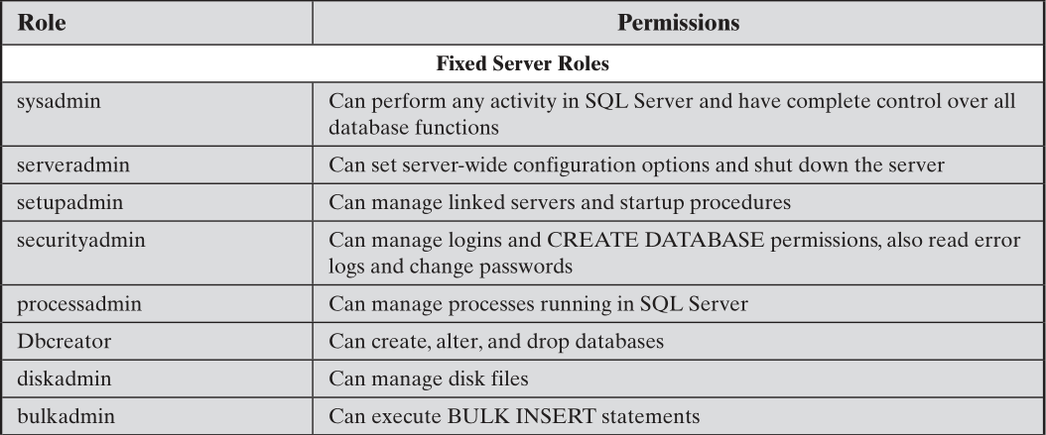
Table 5.2 Fixed Roles in Microsoft SQL Server

Slide 50
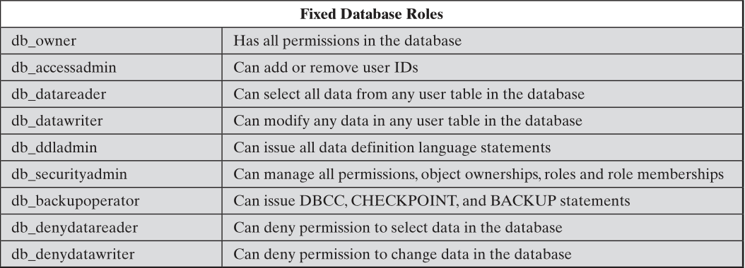
Table 5.2 Fixed Roles in Microsoft SQL Server
SQL Server allows users to create roles.
These user-defined roles can then be assigned access rights to portions of the database.
A user with proper authorization (typically, a user assigned to the db_securityadmin role) may define a new role and associate access rights with the role.

Slide 51
Inference 推理

Slide 52
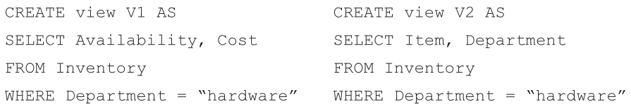
Inference 推理
The process of performing authorized queries and deducing unauthorized information from the legitimate responses received.
When the combination of a number of data items is more sensitive than the individual items
When a combination of data items can be used to infer data of higher sensitivity

Slide 53
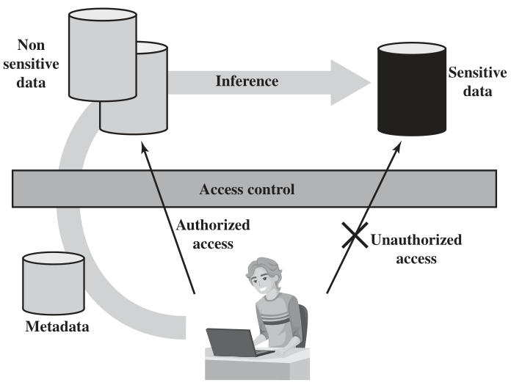
Figure 5.7 Indirect Information Access via Inference Channel

Slide 54
Inference 推理
Metadata refers to knowledge about correlations or dependencies among data items that can be used to deduce information not otherwise available to a particular user.
The information transfer path by which unauthorized data is obtained is referred to as an inference channel.
2 inference techniques
Analyzing functional dependencies between attributes within a table or across tables
Merging views with the same constraints

Slide 55
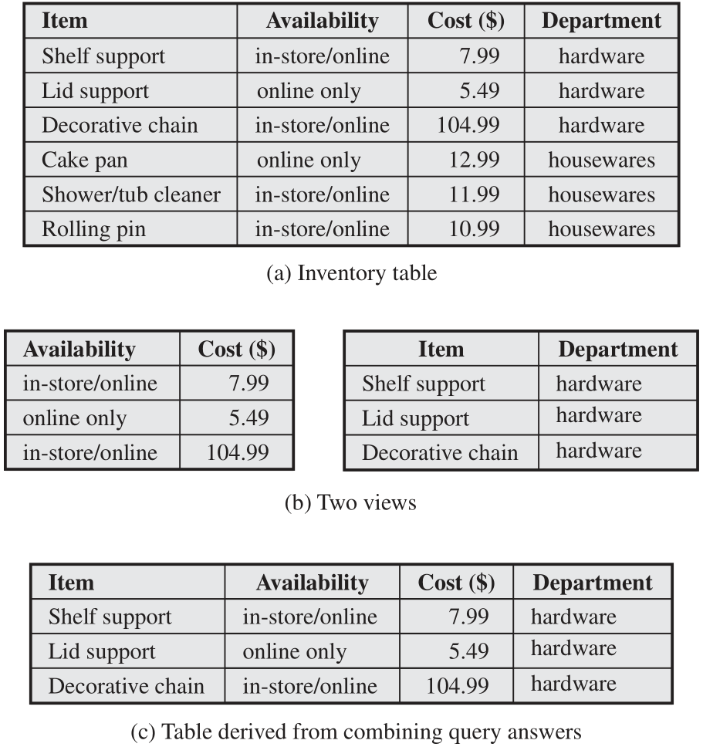
Figure 5.8 Inference Example

Slide 56
Inference Detection Two approaches
Inference detection during database design
Approach removes an inference channel by altering the database structure or by changing the access control regime to prevent inference
Techniques in this category often result in unnecessarily stricter access controls that reduce availability
Inference detection at query time
Approach seeks to eliminate an inference channel violation during a query or series of queries
If an inference channel is detected, the query is denied or altered

Slide 57
Database Encryption 資料庫加密

Slide 58
Database Encryption 資料庫加密
The database is typically the most valuable information resource for any organization
Protected by multiple layers of security
Firewalls, authentication, general access control systems, DB access control systems, database encryption
Encryption becomes the last line of defense in database security
Can be applied to the entire database, at the record level, the attribute level, or level of the individual field

Slide 59
Database Encryption 資料庫加密
Disadvantages to Encryption
Key management
Authorized users must have access to the decryption key for the data for which they have access
Inflexibility
When part or all of the database is encrypted it becomes more difficult to perform record searching

Slide 60
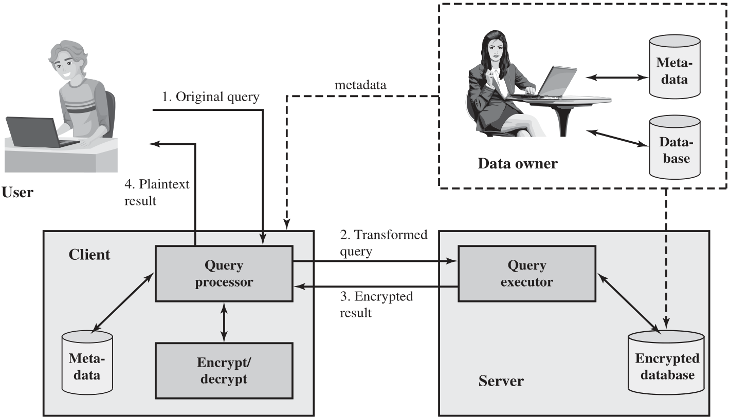
Figure 5.9 A Database Encryption Scheme

Slide 61
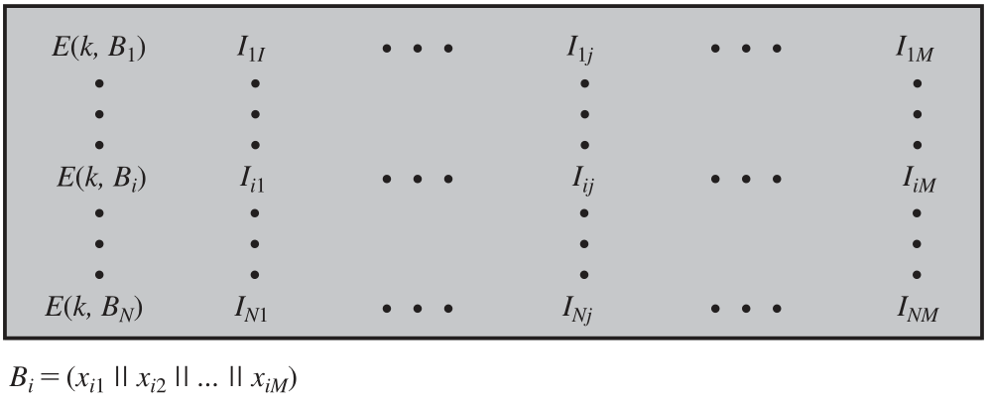
Figure 5.10 Encryption Scheme for Database of Figure 5.3

Slide 62
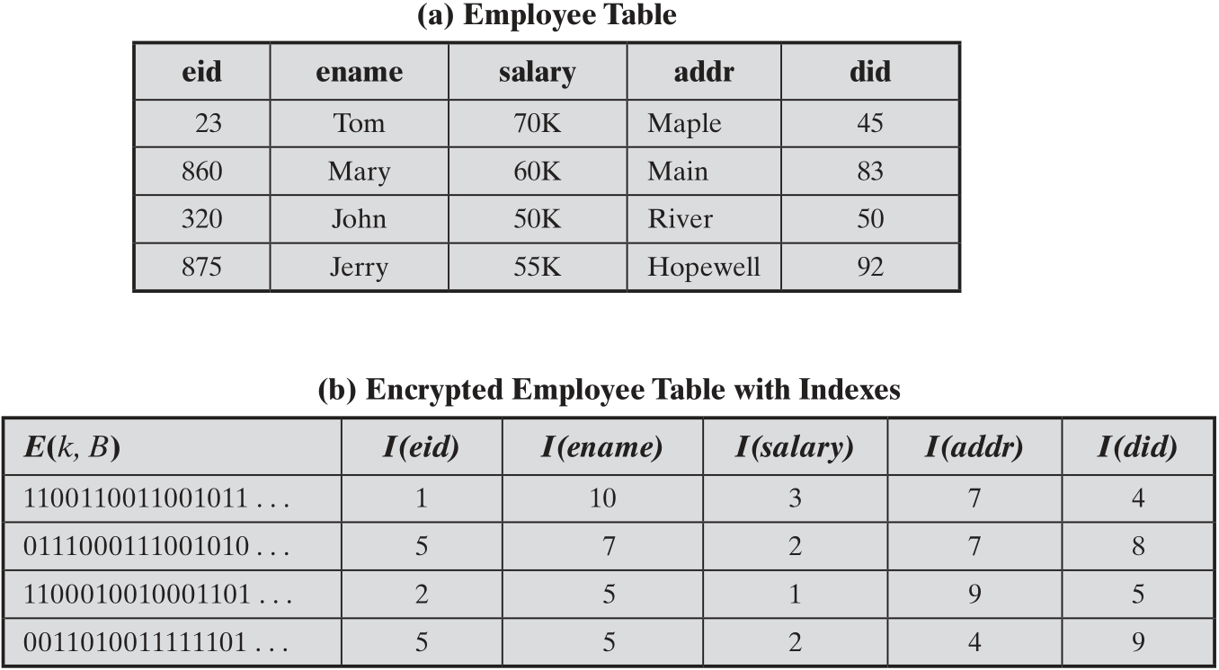
Table 5.3 Encrypted Database Example

Slide 63
Data Center Security
Data center:
An enterprise facility that houses a large number of servers, storage devices, and network switches and equipment
The number of servers and storage devices can run into the tens of thousands in one facility
Generally includes redundant or backup power supplies, redundant network connections, environmental controls, and various security devices
Can occupy one room of a building, one or more floors, or an entire building
Examples of uses include:
Cloud service providers
Search engines
Large scientific research facilities
IT facilities for large enterprises

Slide 64

給人參觀的 Data Center

Slide 65
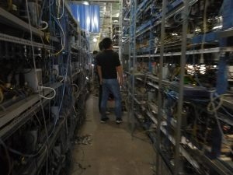
不給人參觀的 Data Center

Slide 66
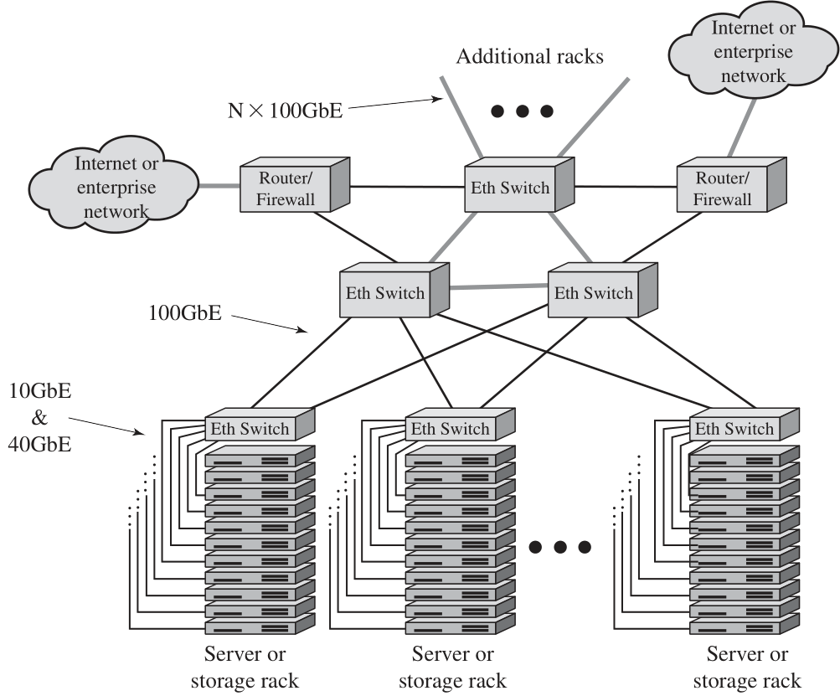
Figure 5.11 Key Data Center Elements

Slide 67
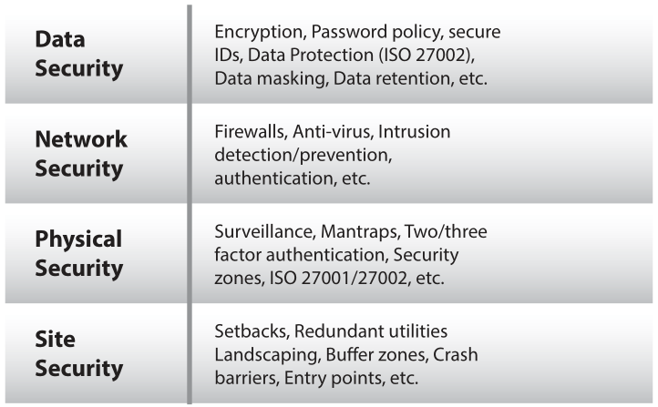
Figure 5.12 Data Center Security Model

Slide 68
TIA-492
The Telecommunications Industry Association (TIA)
TIA-492 (Telecommunications Infrastructure Standard for Data Centers) specifies the minimum requirements for telecommunications infrastructure of data centers
Includes topics such as:
Network architecture
Electrical design
File storage, backup, and archiving
System redundancy
Network access control and security
Database management
Web hosting
Application hosting
Content distribution
Environmental control
Protection against physical hazards
Power management

Slide 69
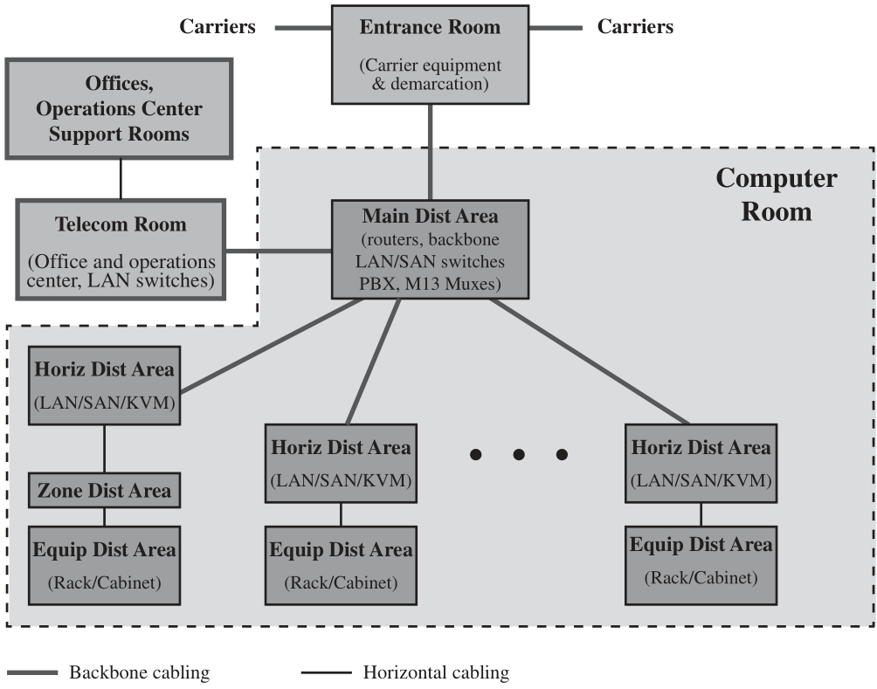
Figure 5.13 TIA-942 Compliant Data Center Showing Key Functional Areas

Slide 70
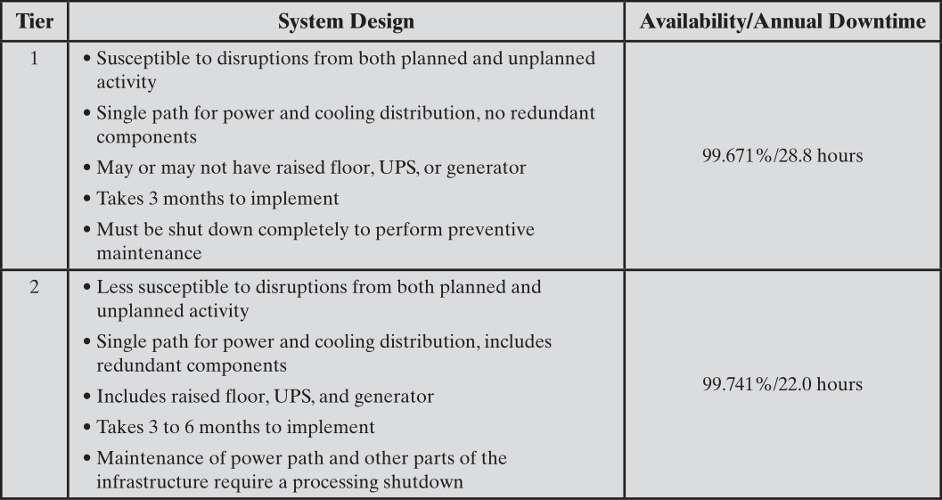
Table 5.4 Data Center Tiers Defined in TIA-942

Slide 71
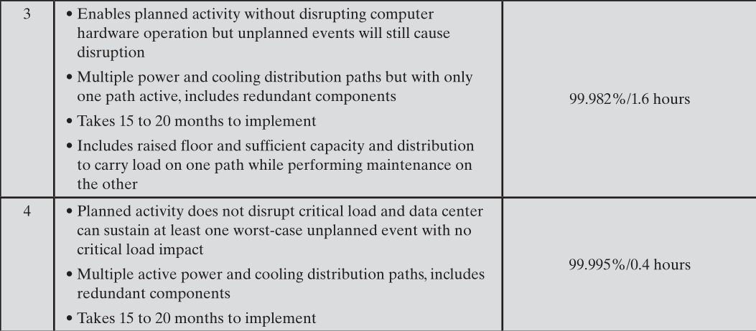
Table 5.4 Data Center Tiers Defined in TIA-942

Slide 72
Summary
The need for database security
Database management systems
Relational databases
Elements of a relational database system
Structured Query Language
SQL injection attacks
A typical SQLi attack
The injection technique
SQLi attack avenues and types
SQLi countermeasures
Database access control
SQL-based access definition
Cascading authorizations
Role-based access control
Inference
Database encryption
Data center security
Data center elements
Data center security considerations
TIA-492
Notes:
Chapter 3 summary.

